Slide 1
Olave 2019 International Camp

Slide 2
The first ever Olave International Camp was held in Battle in 1989!

Slide 3
Since Olave ‘89 Girlguiding Sussex East County has hosted an international camp every four to five years!

Slide 4
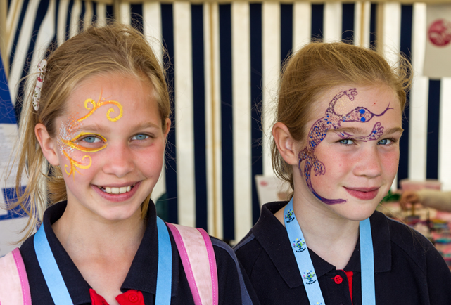
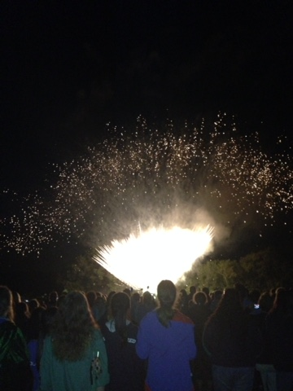
Olave 2019
Olave 2019 is being held 30 years after our first International Camp and we would like YOU to come and help us celebrate by joining in the fun and having a great time!

Slide 5
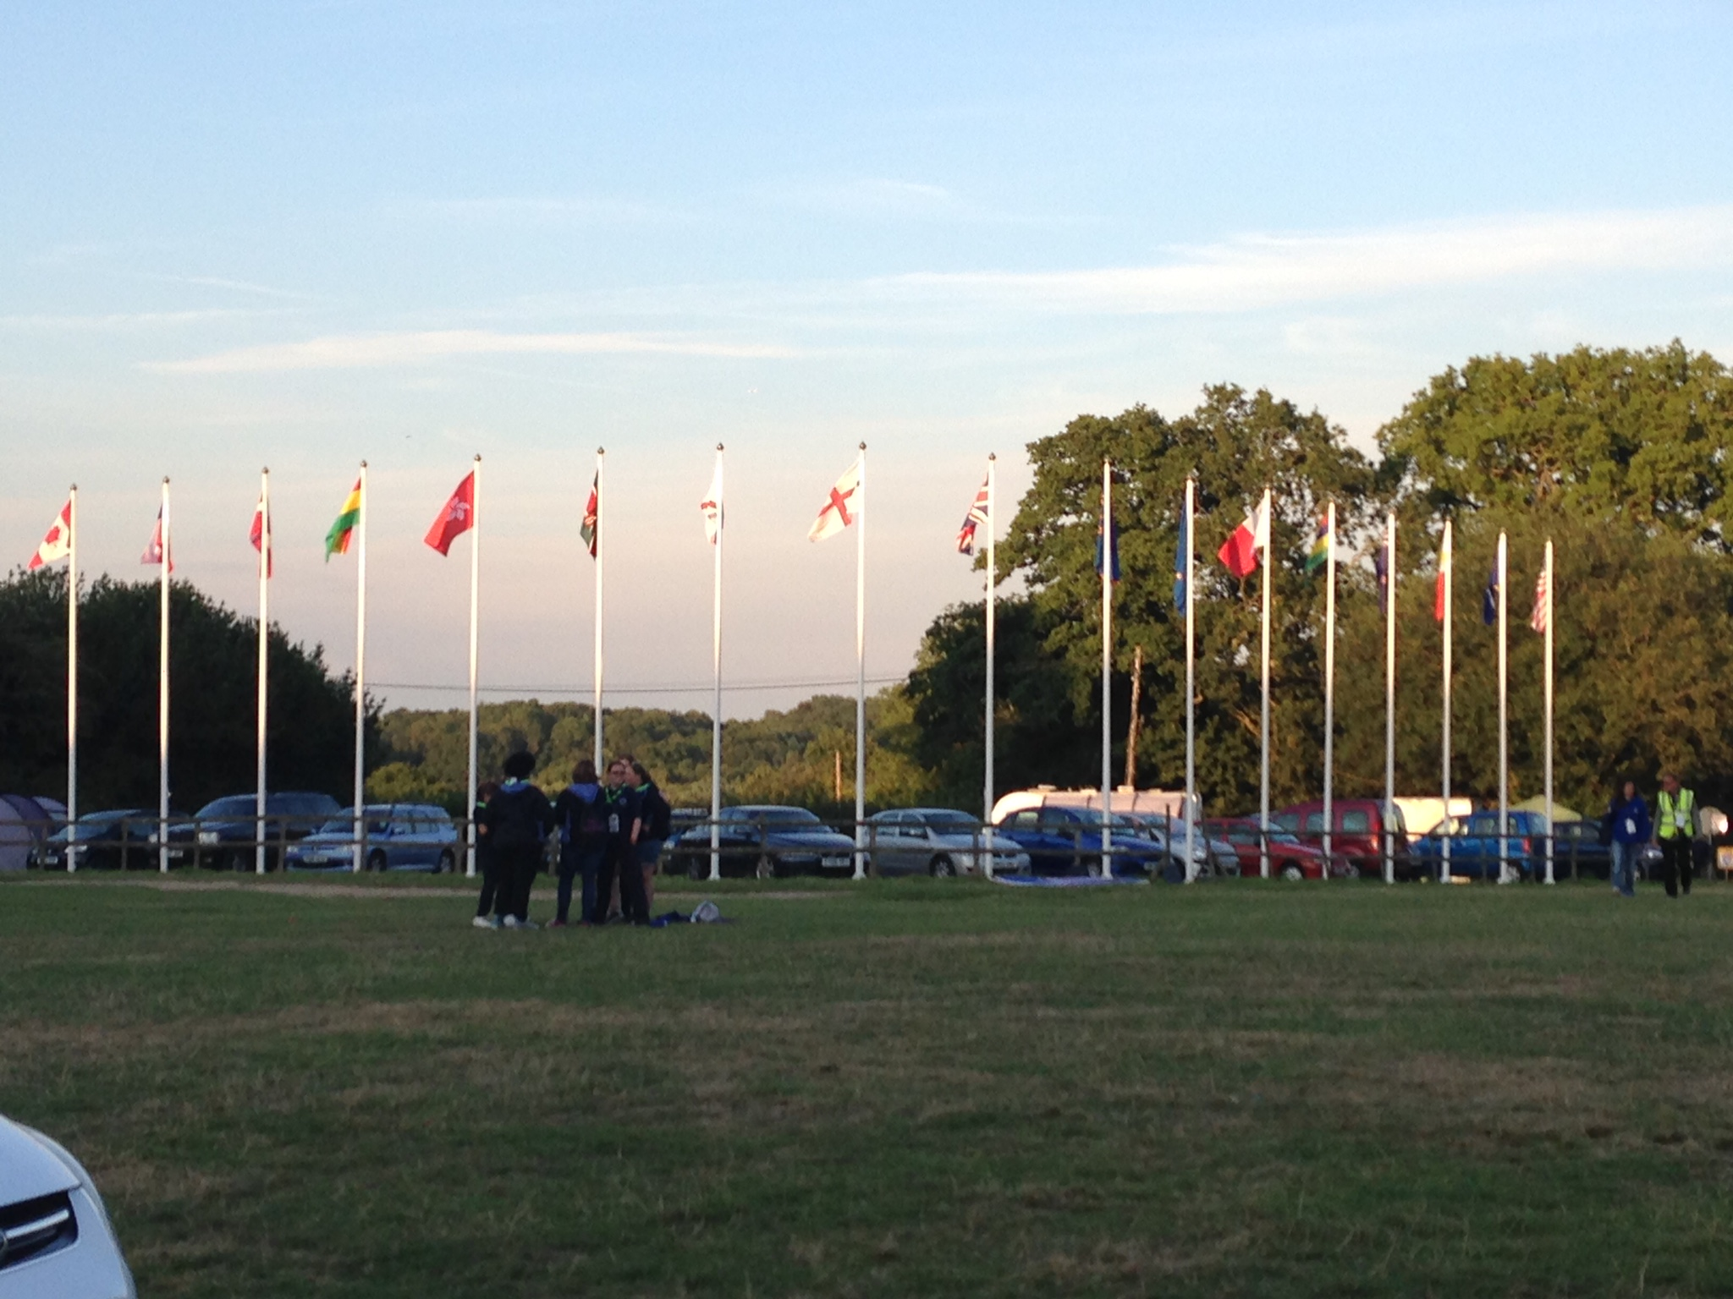
Olave 2019
Olave 2019 will be an amazing camp, held here in Sussex, with international guests and other Guide units from across the UK

Slide 6
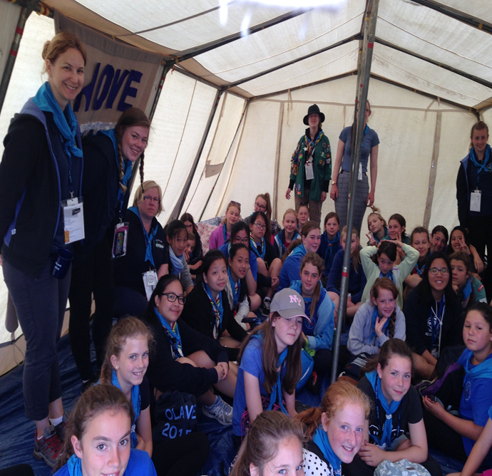
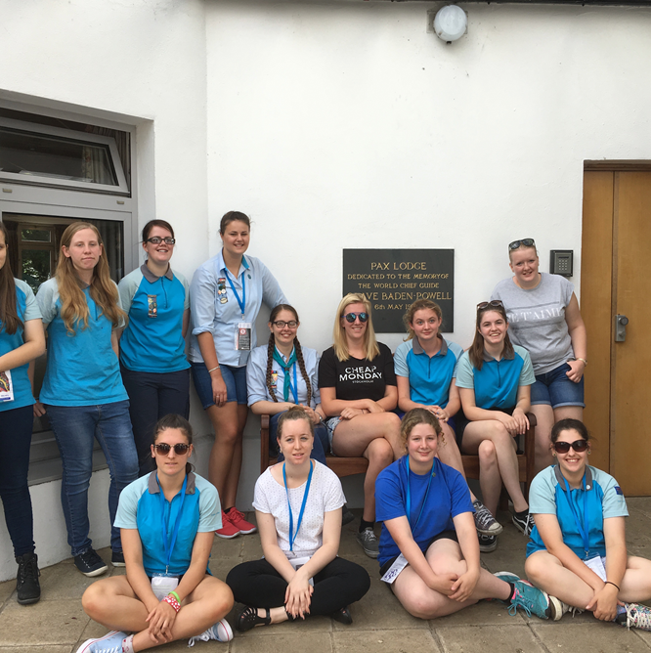
Olave 2019
When is it?
Saturday 27 July to Saturday 3 August 2019
Who can go?
Guides and members of The Senior Section

Slide 7
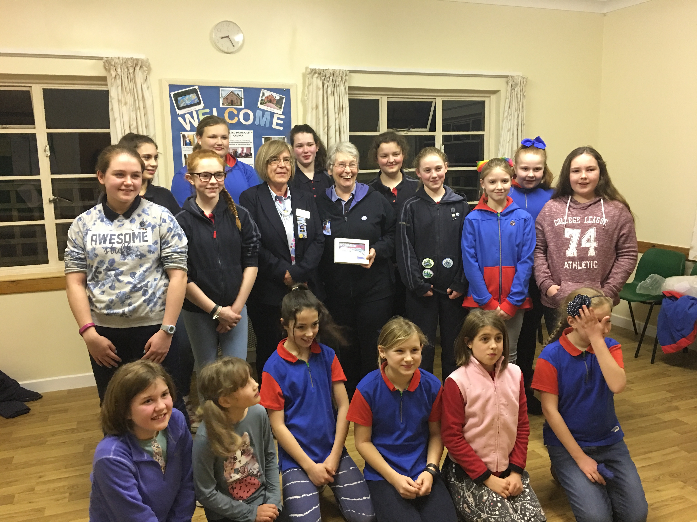
Olave 2019
Members of Girlguiding from across the UK, and international guests, will also be there

Slide 8
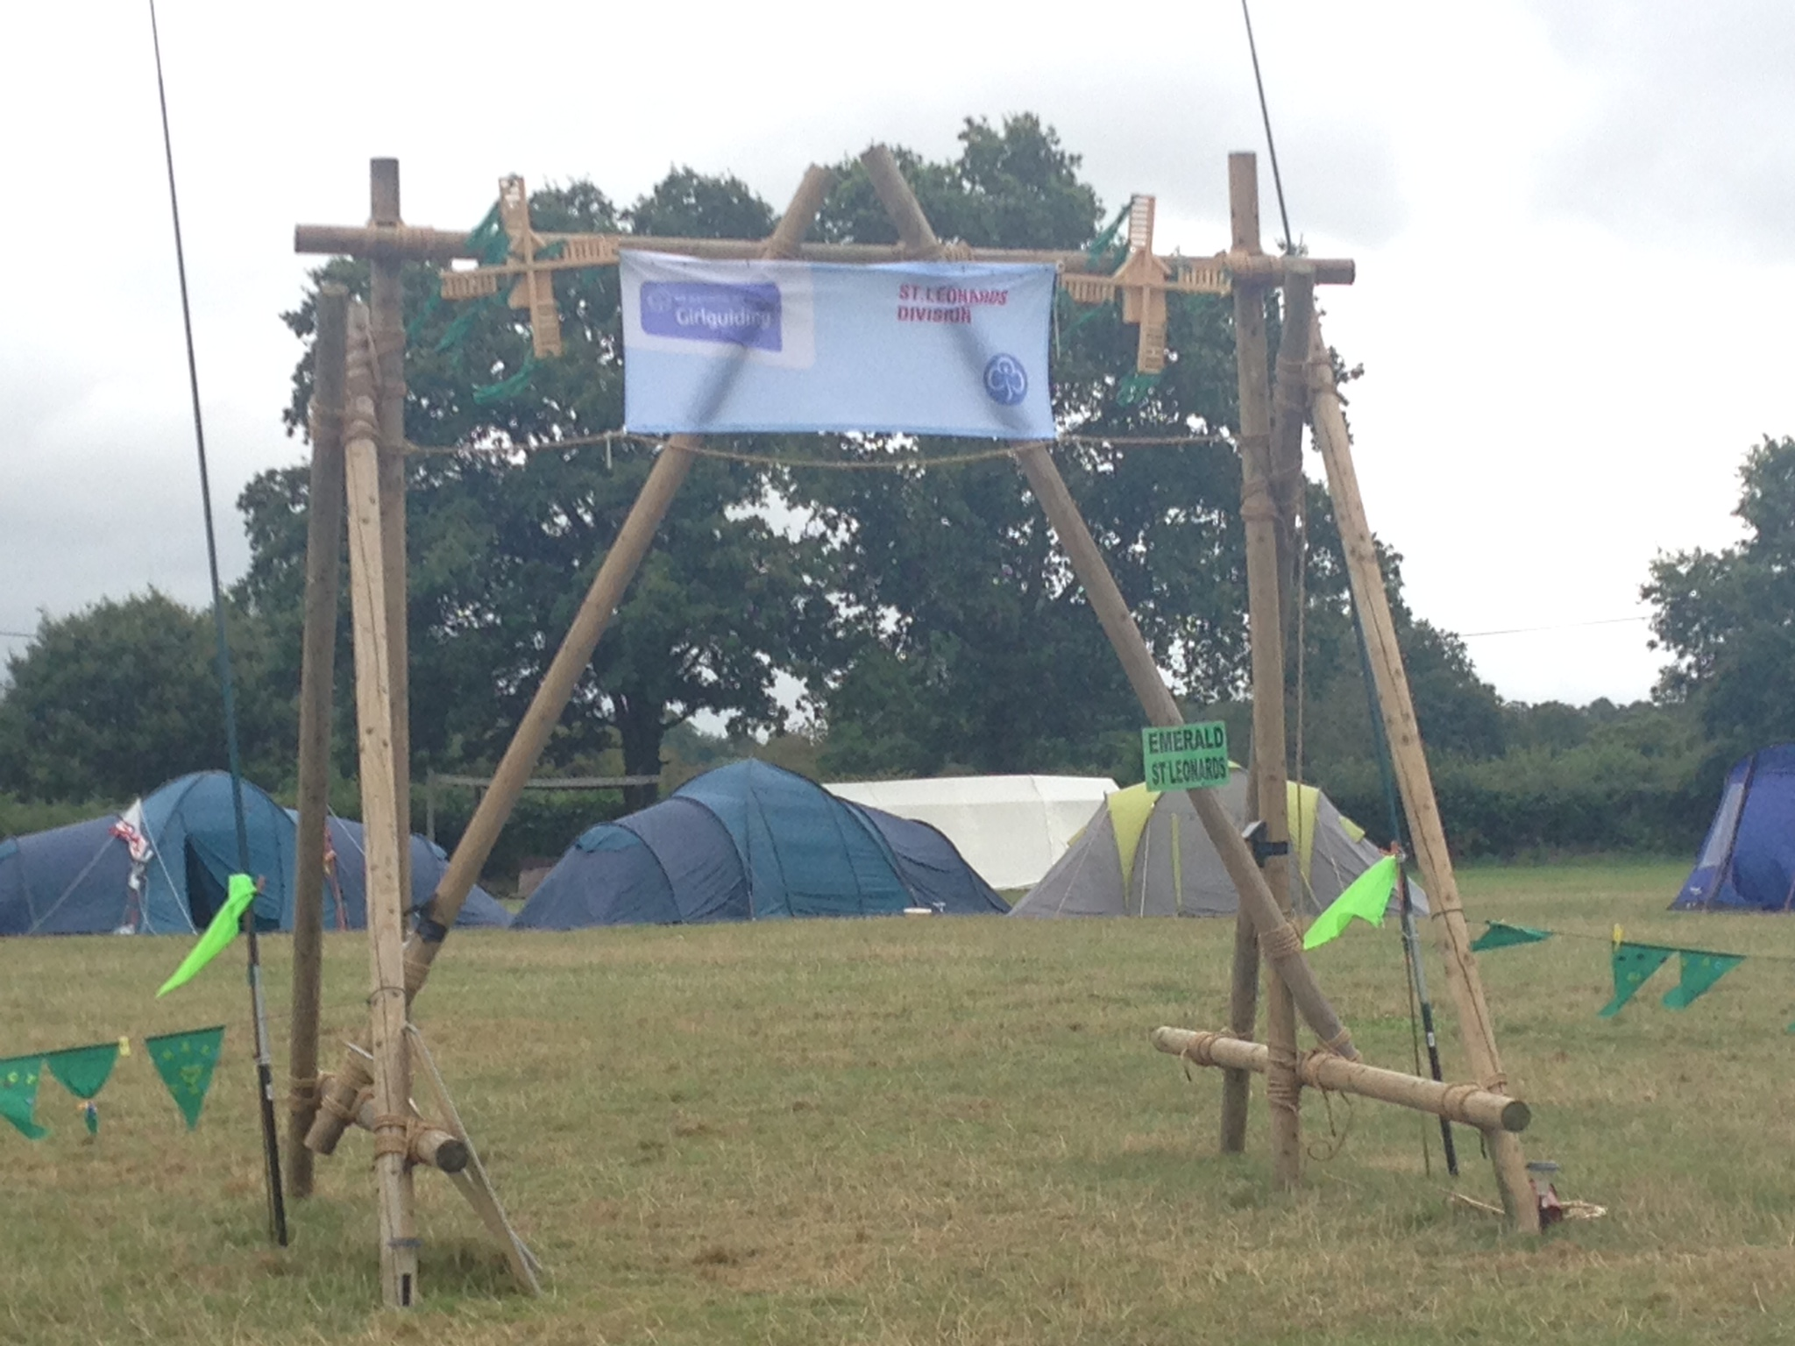
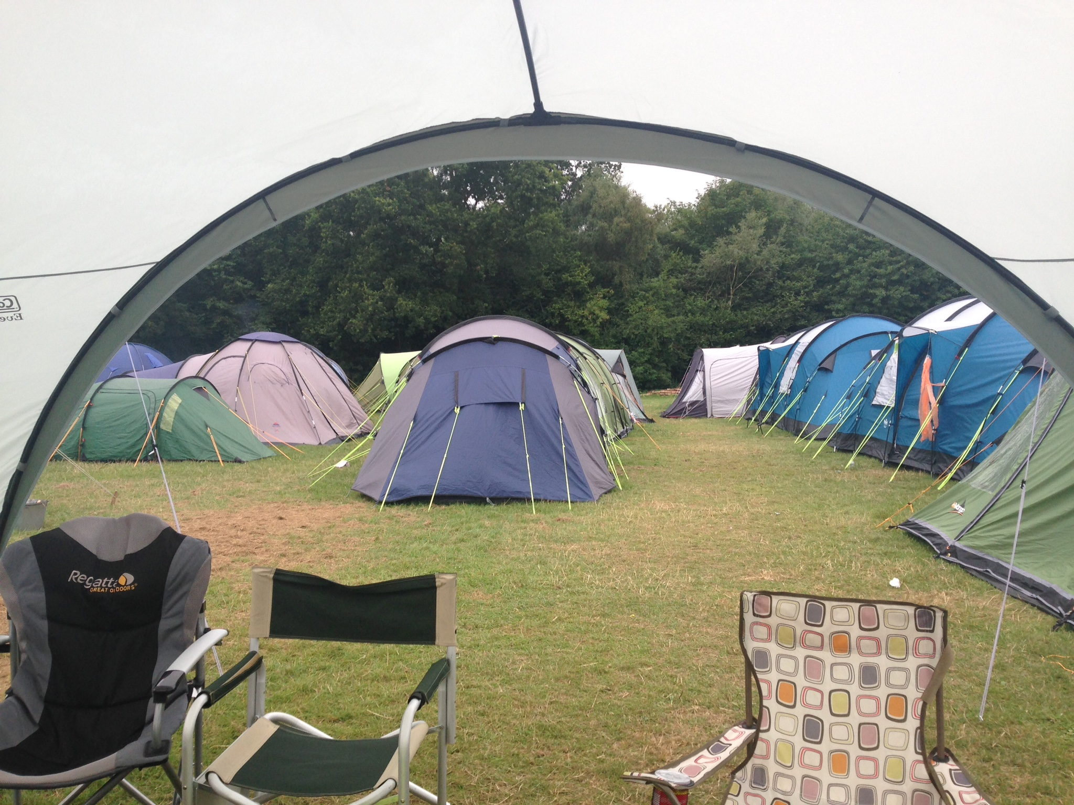
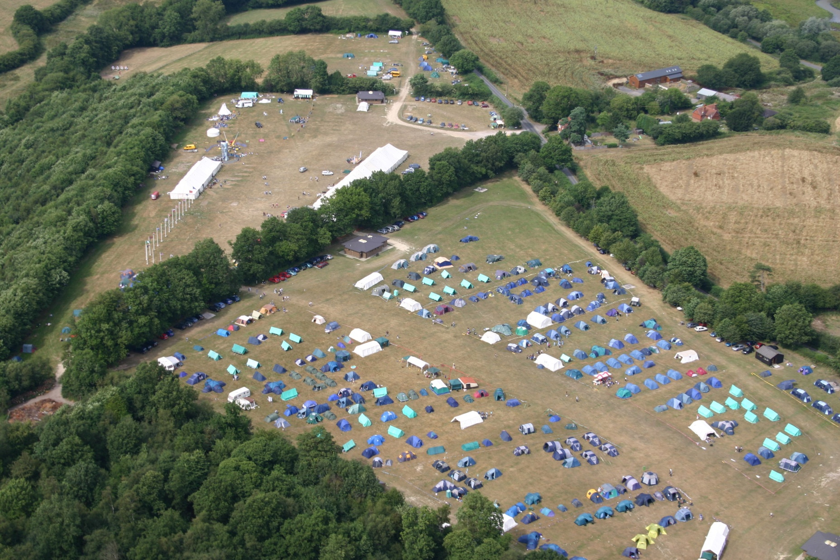
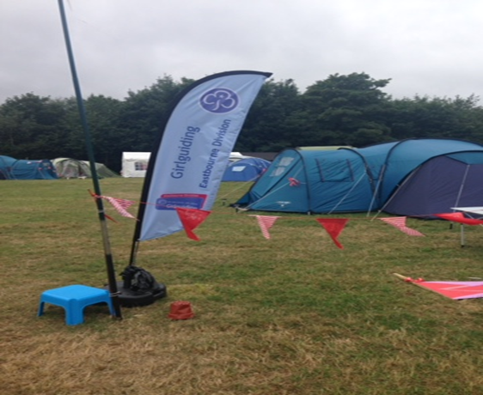
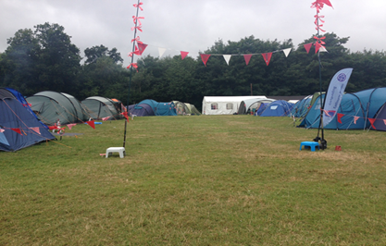
Olave 2019
How will the girls camp?
There will be division sub camps, with international guests joining many.
Members will be able to come to Olave 2019 with or without their unit leaders

Slide 9
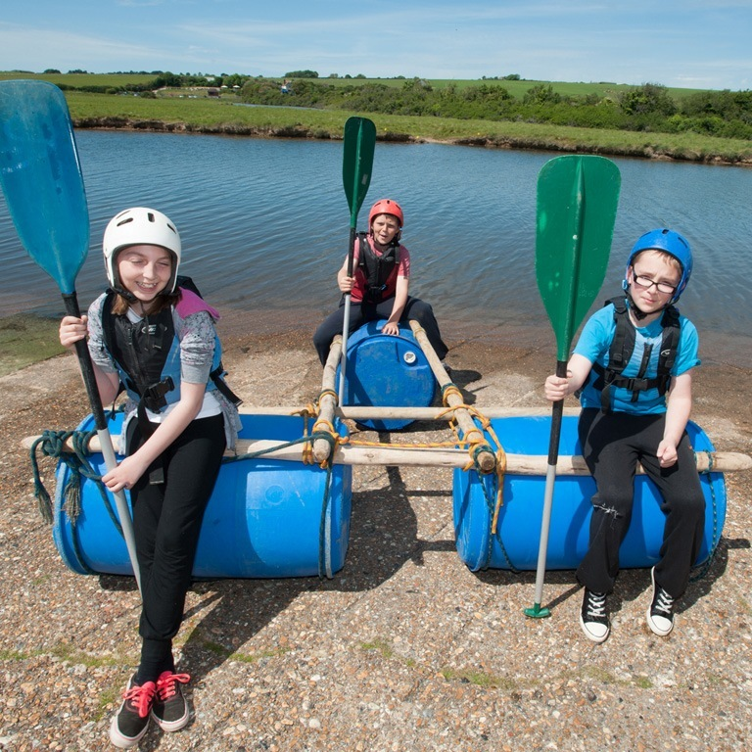
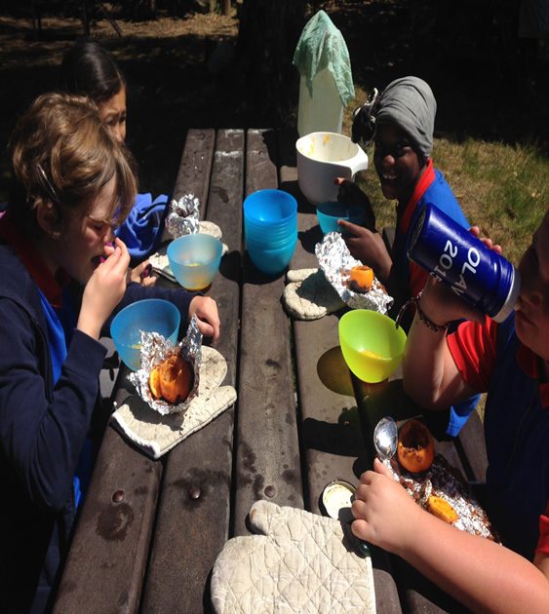
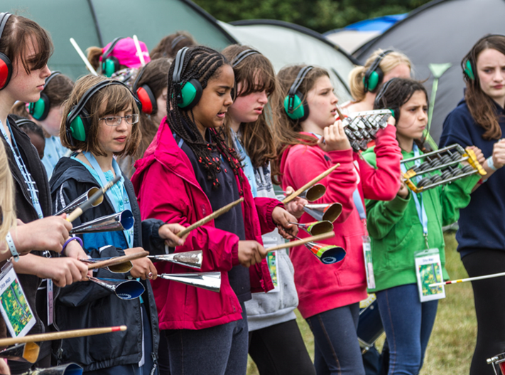
Olave 2019
What activities happen at International Camp?

Slide 10
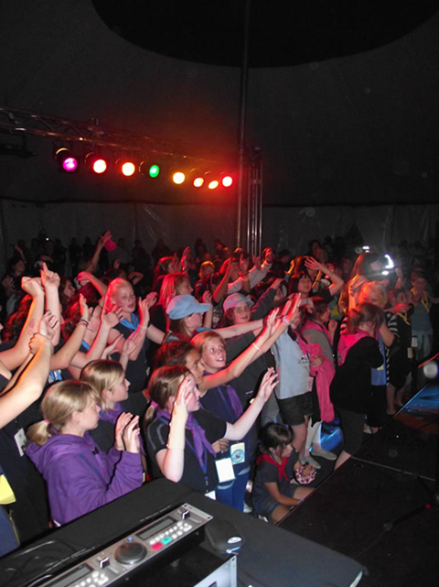
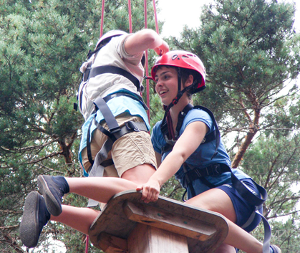
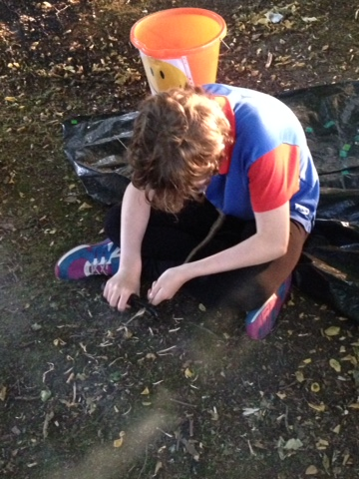
Olave 2019
What activities happen at International Camp?

Slide 11
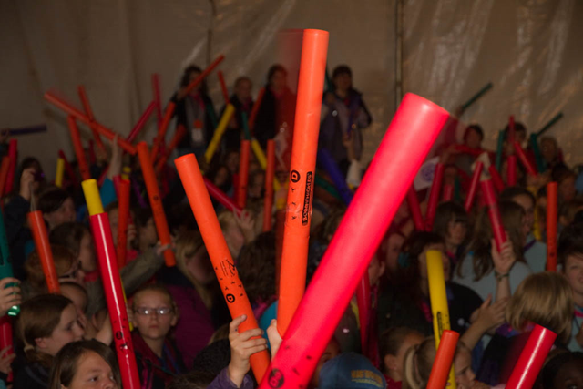
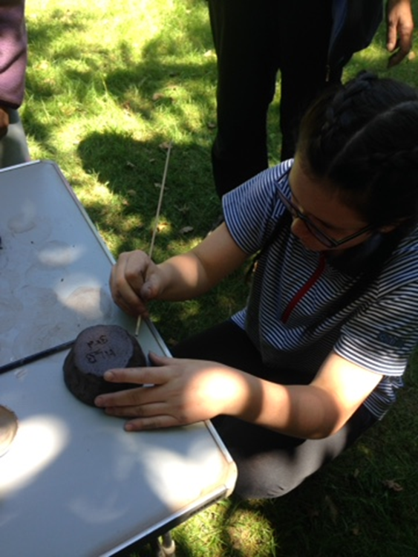
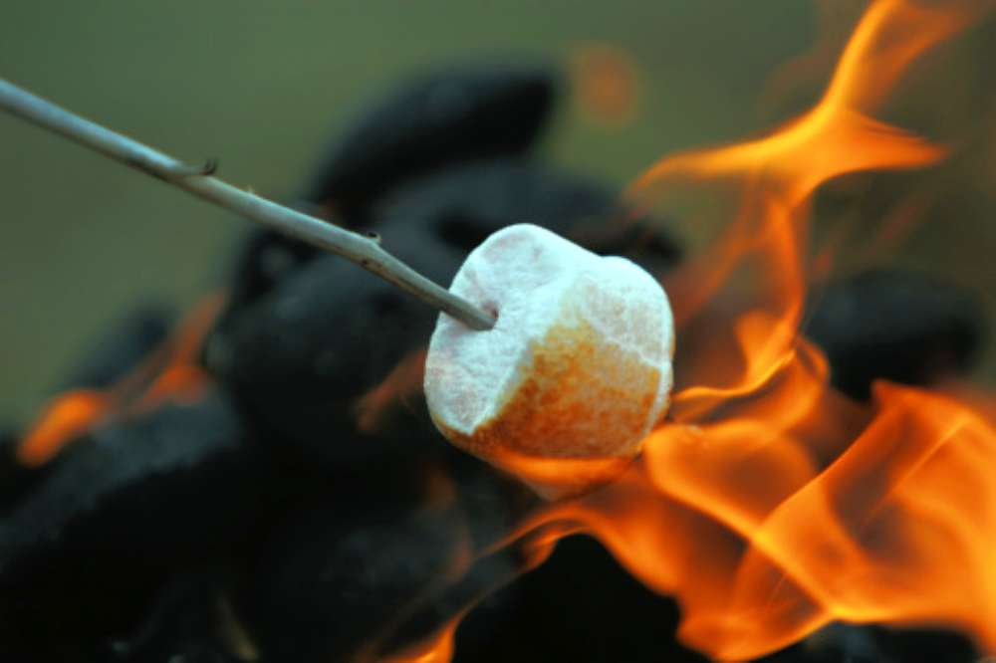
Olave 2019
What activities happen at International Camp?

Slide 12
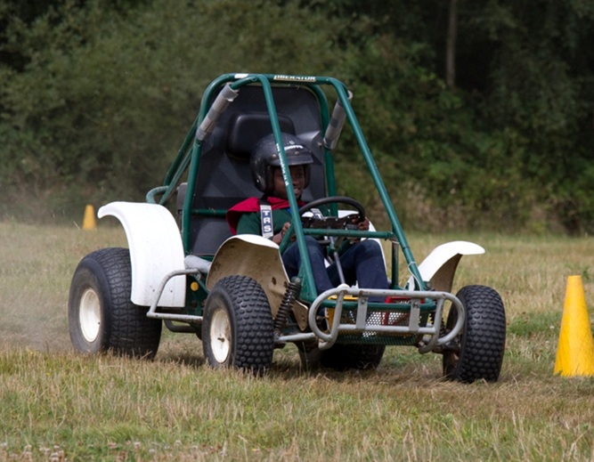
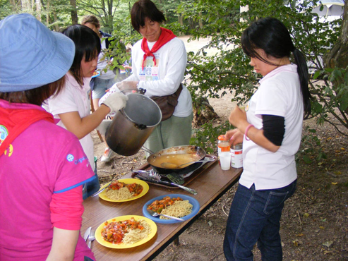
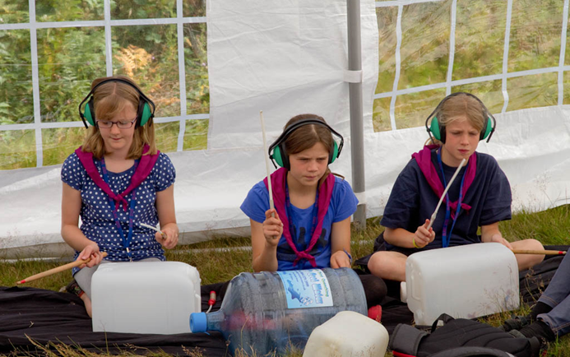
Olave 2019
What activities happen at International Camp?

Slide 13
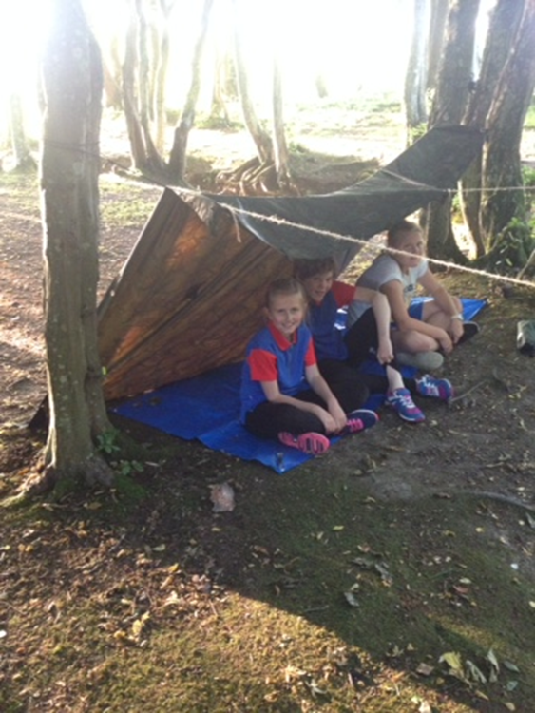
Olave 2019
What activities happen at International Camp?

Slide 14
Olave 2019
What does the cost include?
A welcome pack with hoodie
An action packed week full of activities
All meals for the week – cooked for you
A chance to meet and make friends from all over the world
An international experience in your own country

Slide 15
Olave 2019
How much will it cost? £340
This includes a grant of £40 which will be awarded to all Girlguiding Sussex East County girls. The deposit of £75 is to be received by 31 July 2018 & other payments are to be received on time.
After 31 July 2018 the grant is no longer available and the full amount of £340 will be payable in instalments.
A second payment of £125 is due by 30th November 2018 and the final payment of £100/£140 is due by 31st March 2019.

Slide 16
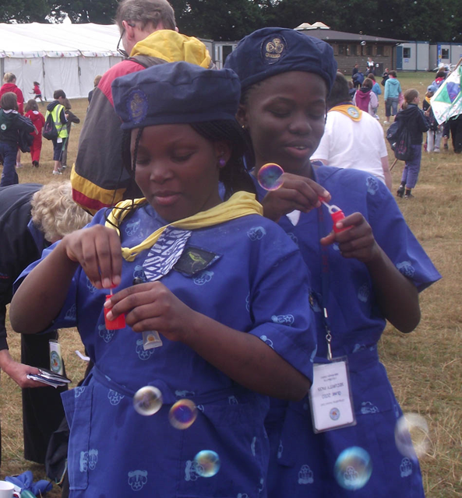
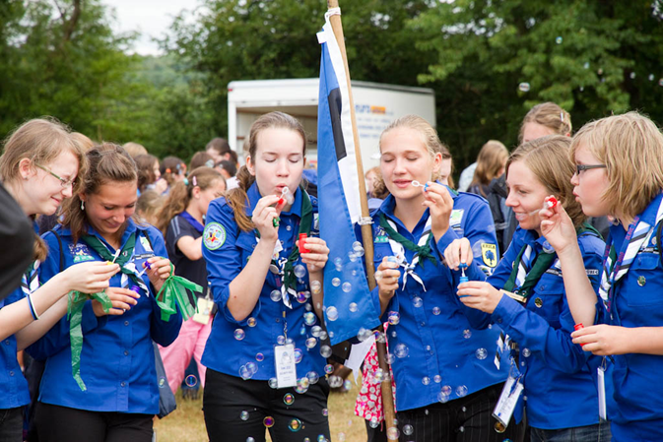
Quotes from previous Olave camps
‘We had such a great time and met people from all over the world.’
‘We tried to change our ways with the global development village and took part in a variety of activities.’

Slide 17
Olave 2019 International Camp
We want to see YOU there so come and join the fun!
☺

